Slide 1
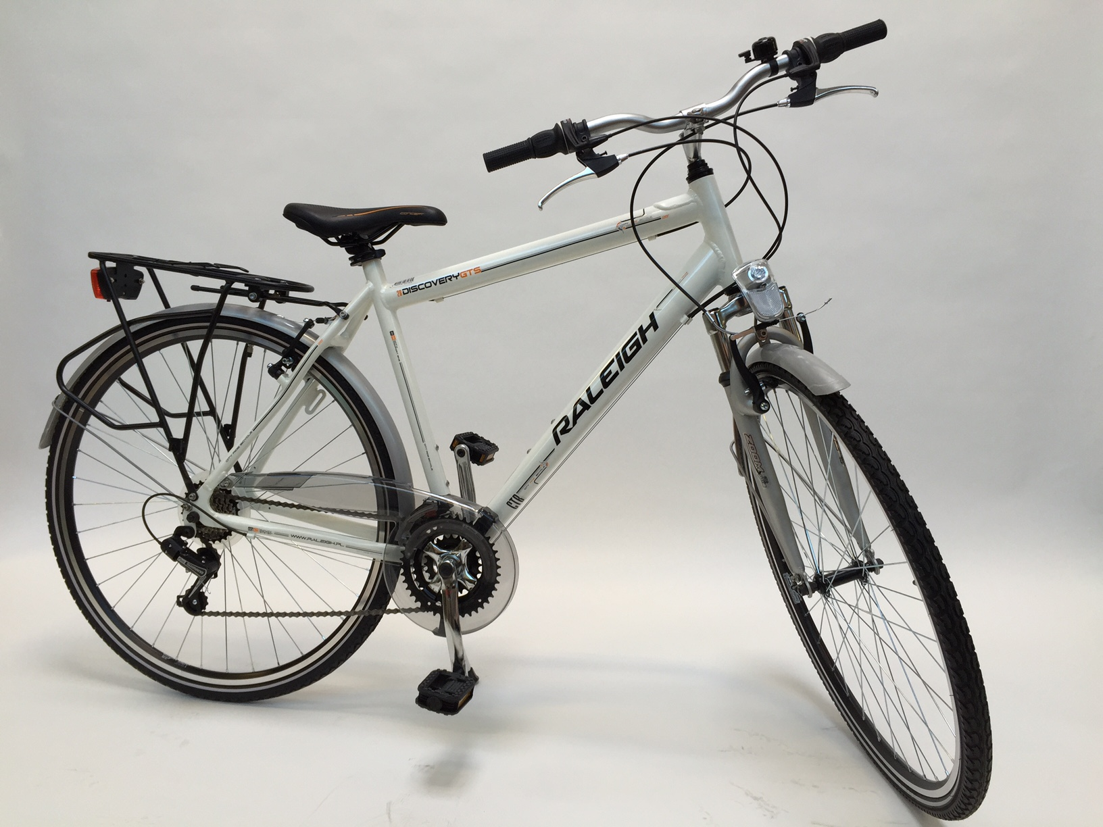
-55%
VANA HIND 499€
225€

